Slide 1
Technology for Success: Computer Concepts

Slide 2
Digital Ethics and Lifestyle
Module 14

Slide 3
Lesson Objectives
Describe legal and ethical responsibilities of a digital citizen
Explain how to be a responsible digital citizen
Campbell/Ciampa/Clemens/Freund/Frydenberg/Hooper/Ruffolo/West, Technology for Success: Computer Concepts, 1st Edition. © 2020 Cengage. All Rights Reserved. May not be scanned, copied or duplicated, or posted to a publicly accessible website, in whole or in part.

Slide 4
Describe Legal and Ethical Responsibilities of a Digital Citizen (1 of 3)
How digital technology has revolutionized society
Characteristics of digital citizenship
Describe the legal, ethical, and moral issues caused by technology
Describe digital inclusion and the importance of digital access
Describe how to create online content without infringing on copyright protections
Campbell/Ciampa/Clemens/Freund/Frydenberg/Hooper/Ruffolo/West, Technology for Success: Computer Concepts, 1st Edition. © 2020 Cengage. All Rights Reserved. May not be scanned, copied or duplicated, or posted to a publicly accessible website, in whole or in part.

Slide 5
Describe Legal and Ethical Responsibilities of a Digital Citizen (2 of 3)
Digital ethics is the set of legal and moral guidelines that govern the use of technology
A digital citizen is anyone who uses or interacts with technology at work or in daily life for productivity or entertainment
Many laws are being debated, revised, and passed to deal with how technology complicates problems
Distracted driving means driving a vehicle while focusing on other activities, typically involving an electronic device such as a cell phone
Campbell/Ciampa/Clemens/Freund/Frydenberg/Hooper/Ruffolo/West, Technology for Success: Computer Concepts, 1st Edition. © 2020 Cengage. All Rights Reserved. May not be scanned, copied or duplicated, or posted to a publicly accessible website, in whole or in part.

Slide 6
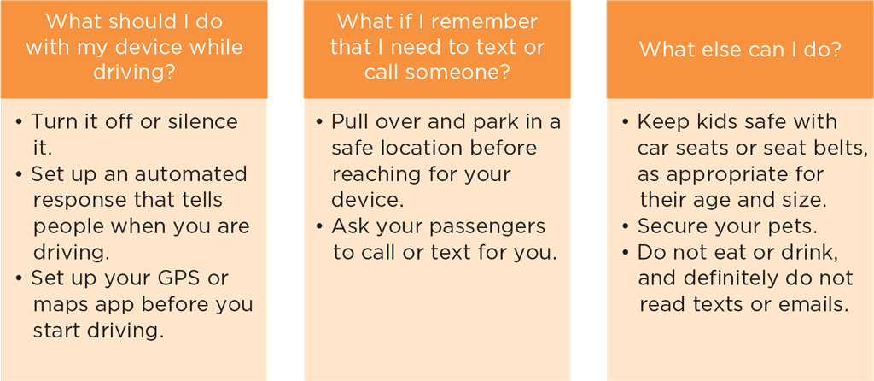
Describe Legal and Ethical Responsibilities of a Digital Citizen (3 of 3)
Figure 14-2: Tips for avoiding distracted driving
Campbell/Ciampa/Clemens/Freund/Frydenberg/Hooper/Ruffolo/West, Technology for Success: Computer Concepts, 1st Edition. © 2020 Cengage. All Rights Reserved. May not be scanned, copied or duplicated, or posted to a publicly accessible website, in whole or in part.

Slide 7
How Digital Technology Has Revolutionized Society
You are likely to live a digital lifestyle, using a variety of technologies for work and play
Smartphones
Tablets
Laptops
Smart devices
Campbell/Ciampa/Clemens/Freund/Frydenberg/Hooper/Ruffolo/West, Technology for Success: Computer Concepts, 1st Edition. © 2020 Cengage. All Rights Reserved. May not be scanned, copied or duplicated, or posted to a publicly accessible website, in whole or in part.

Slide 8
Characteristics of Digital Citizenship
Digital literacy: having a current knowledge and understanding of technology and an ability to use it, combined with an awareness of commonly used technologies
Digital citizenship: ethical, legal, and productive use of technology
Acceptable use policy (AUP): document that lists guidelines and repercussions of use of the Internet and other digital company resources, including network storage, and email servers
Distributed in part to reduce an organization’s liability and to clarify what is and isn’t a fire-able offense
Includes code of conduct
Campbell/Ciampa/Clemens/Freund/Frydenberg/Hooper/Ruffolo/West, Technology for Success: Computer Concepts, 1st Edition. © 2020 Cengage. All Rights Reserved. May not be scanned, copied or duplicated, or posted to a publicly accessible website, in whole or in part.

Slide 9
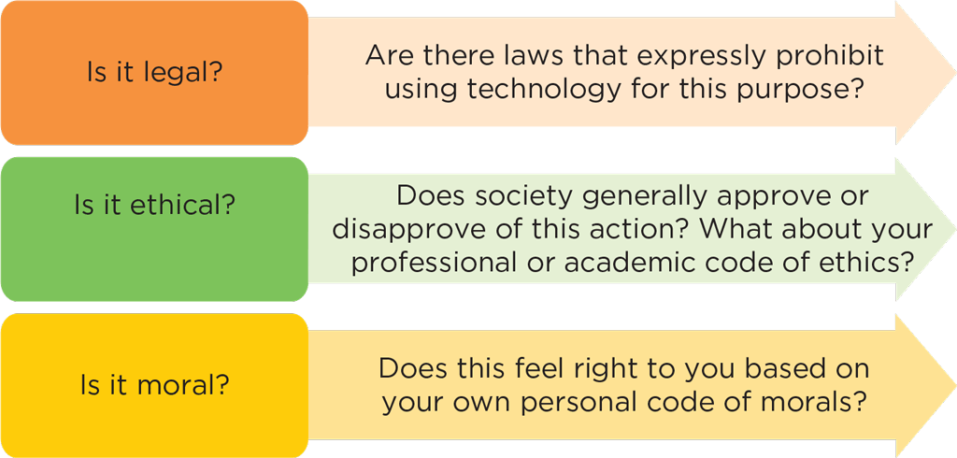
Describe the Legal, Ethical, and Moral Issues Caused by Technology
Technology use can have legal, ethical, and moral consequences
Figure 14-6: There are many gray areas when determining how to use technology
Campbell/Ciampa/Clemens/Freund/Frydenberg/Hooper/Ruffolo/West, Technology for Success: Computer Concepts, 1st Edition. © 2020 Cengage. All Rights Reserved. May not be scanned, copied or duplicated, or posted to a publicly accessible website, in whole or in part.

Slide 10
Describe Digital Inclusion and the Importance of Digital Access
The Internet of Things (IoT) is the network of all products and equipment that contain processors and can communicate with one another via the Internet
IoT-enabled devices can be controlled or programmed by apps, voice, or motion
Some people cannot afford IoT technologies, or lack the necessary access to high-speed, uncensored Internet connections, putting them at a disadvantage
The digital divide is the gap between those who have access to technology and its resources and information and those who do not
Campbell/Ciampa/Clemens/Freund/Frydenberg/Hooper/Ruffolo/West, Technology for Success: Computer Concepts, 1st Edition. © 2020 Cengage. All Rights Reserved. May not be scanned, copied or duplicated, or posted to a publicly accessible website, in whole or in part.

Slide 11
Describe How to Create Online Content without Infringing on Copyright Protections
Area | Examples
Intellectual property rights | Legal rights protecting those who create works such as photos, art, writing, inventions, and music
Copyright | An originator’s exclusive legal right to reproduce, publish, or sell intellectual property
Digital rights management (DRM) | A collection of technologies used by software publishers and trade groups to fight software piracy and prevent unauthorized copying of digital content; includes authentication, certificates of authenticity, encryption, and digital watermarks
Public domain | An item available to the public without requiring permission to use, and therefore not subject to copyright
Fair use doctrine | A section of U.S. copyright law that permits the limited use of a part of a work without permission for non-commercial or educational purposes, as long as you include a citation to the original source; limits on fair use have to do with the overall impact of reuse on the value of the work, the nature of the work (for example, song lyrics have different limitations than research papers), and the amount of the work cited
Creative Commons | A non-profit organization that makes it easy for content creators to license and share their work by supplying easy-to-understand copyright licenses that allow the creator to choose the conditions under which the work can be used
Table 14-2: Content protection terms
Campbell/Ciampa/Clemens/Freund/Frydenberg/Hooper/Ruffolo/West, Technology for Success: Computer Concepts, 1st Edition. © 2020 Cengage. All Rights Reserved. May not be scanned, copied or duplicated, or posted to a publicly accessible website, in whole or in part.

Slide 12
How to be a Responsible Digital Citizen (1 of 2)
Recognize how to cultivate a polite online presence
Describe what makes an online source reliable
Describe how to develop accessible online content
Identify best practices for avoiding risks related to digital technology
Explain how to create a digital wellness plan
Identify best practices for responsible tech disposal
Campbell/Ciampa/Clemens/Freund/Frydenberg/Hooper/Ruffolo/West, Technology for Success: Computer Concepts, 1st Edition. © 2020 Cengage. All Rights Reserved. May not be scanned, copied or duplicated, or posted to a publicly accessible website, in whole or in part.

Slide 13
How to be a Responsible Digital Citizen (2 of 2)
Technology changes so quickly that it often raises issues not covered by current law
Responsible digital citizens must sometimes make their own decisions about what’s right and what’s wrong
The first step in evaluating a situation involving digital ethics is to consider whether an action would be acceptable if it were done without using technology
Campbell/Ciampa/Clemens/Freund/Frydenberg/Hooper/Ruffolo/West, Technology for Success: Computer Concepts, 1st Edition. © 2020 Cengage. All Rights Reserved. May not be scanned, copied or duplicated, or posted to a publicly accessible website, in whole or in part.

Slide 14
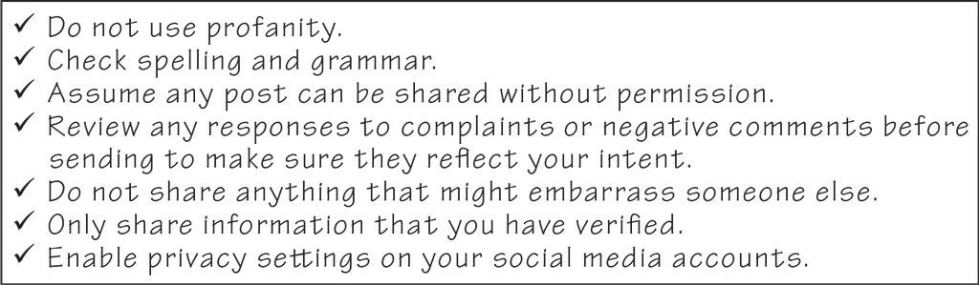
Recognize How to Cultivate a Polite Online Presence
Figure 14-9: Keep your digital footprint professional
Campbell/Ciampa/Clemens/Freund/Frydenberg/Hooper/Ruffolo/West, Technology for Success: Computer Concepts, 1st Edition. © 2020 Cengage. All Rights Reserved. May not be scanned, copied or duplicated, or posted to a publicly accessible website, in whole or in part.

Slide 15
Describe What Makes an Online Source Reliable (1 of 2)
The Internet makes vast amounts of information easily available, but a great deal of it is inaccurate and biased
Content published by libraries, universities, professional organizations, and governmental agencies tends to be reliable
If the responsible organization or author of content is unknown to you, research the source by name to see if others view it as a respected authority
It’s important to be especially careful when using a wiki, which is a collaborative website that allows users to publish and modify content on a webpage
Campbell/Ciampa/Clemens/Freund/Frydenberg/Hooper/Ruffolo/West, Technology for Success: Computer Concepts, 1st Edition. © 2020 Cengage. All Rights Reserved. May not be scanned, copied or duplicated, or posted to a publicly accessible website, in whole or in part.

Slide 16
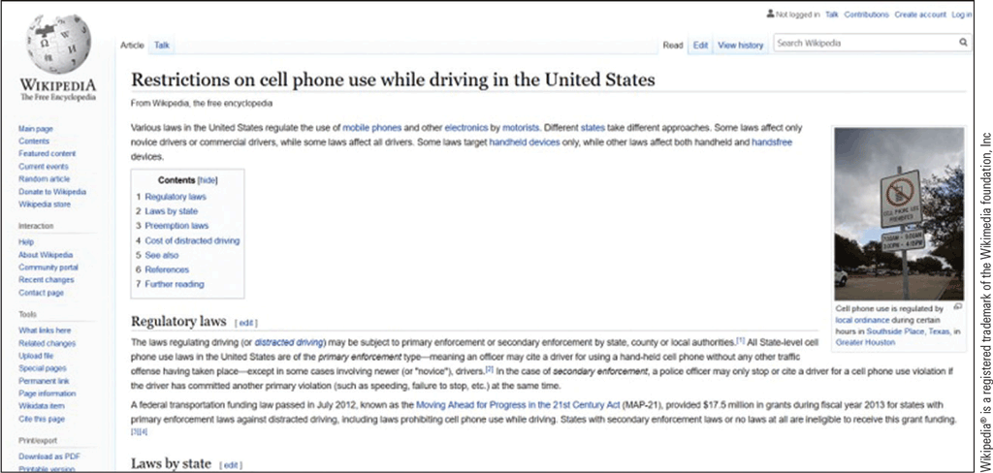
Describe What Makes an Online Source Reliable (2 of 2)
Figure 14-10: Wikipedia is a collaborative website that allows users to publish and modify content
Campbell/Ciampa/Clemens/Freund/Frydenberg/Hooper/Ruffolo/West, Technology for Success: Computer Concepts, 1st Edition. © 2020 Cengage. All Rights Reserved. May not be scanned, copied or duplicated, or posted to a publicly accessible website, in whole or in part.

Slide 17
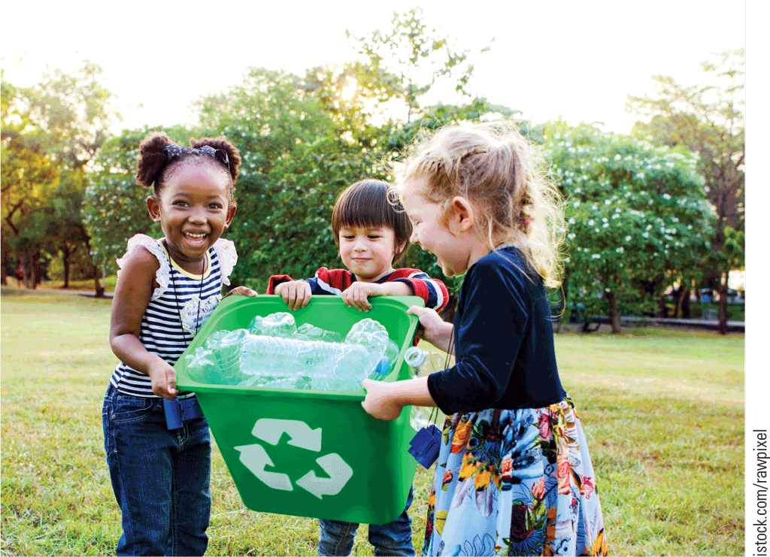
Describe How to Develop Accessible Online Content (1 of 2)
The Americans with Disabilities Act requires online content, including websites, to be accessible to people with disabilities
Accessibility refers to content that is adaptable or available to users who require assistance
Figure 14-11: Good alt text provides visual descriptions
Campbell/Ciampa/Clemens/Freund/Frydenberg/Hooper/Ruffolo/West, Technology for Success: Computer Concepts, 1st Edition. © 2020 Cengage. All Rights Reserved. May not be scanned, copied or duplicated, or posted to a publicly accessible website, in whole or in part.

Slide 18
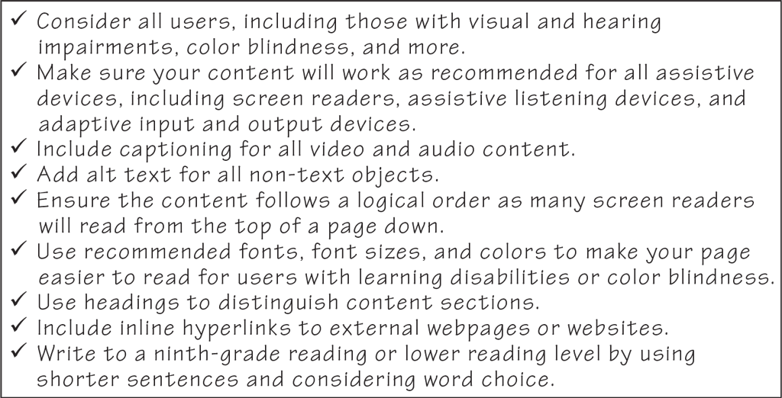
Describe How to Develop Accessible Online Content (2 of 2)
Figure 14-12: Technology raises many ethical and legal questions
Campbell/Ciampa/Clemens/Freund/Frydenberg/Hooper/Ruffolo/West, Technology for Success: Computer Concepts, 1st Edition. © 2020 Cengage. All Rights Reserved. May not be scanned, copied or duplicated, or posted to a publicly accessible website, in whole or in part.

Slide 19
Identify Best Practices for Avoiding Risks Related to Digital Technology
Experts recommend taking occasional breaks from digital devices
A digital detox is a period of time during which an individual refrains from using technology
Has behavioral health benefits, including better sleep, less anxiety, and more productive thought
Can help alleviate physical problems such as eye strain and repetitive stress injuries
Campbell/Ciampa/Clemens/Freund/Frydenberg/Hooper/Ruffolo/West, Technology for Success: Computer Concepts, 1st Edition. © 2020 Cengage. All Rights Reserved. May not be scanned, copied or duplicated, or posted to a publicly accessible website, in whole or in part.

Slide 20
Explain How to Create a Digital Wellness Plan (1 of 2)
To prevent or reduce the physical effects of long-term technology use, follow these practices:
Take hourly breaks
Correct your posture
Don’t text and walk
Stand up while you work at your desk
Resist succumbing to a sedentary lifestyle
Campbell/Ciampa/Clemens/Freund/Frydenberg/Hooper/Ruffolo/West, Technology for Success: Computer Concepts, 1st Edition. © 2020 Cengage. All Rights Reserved. May not be scanned, copied or duplicated, or posted to a publicly accessible website, in whole or in part.

Slide 21
Explain How to Create a Digital Wellness Plan (2 of 2)
To prevent or reduce the behavioral health effects of long-term technology use, follow these practices:
Take frequent breaks and consider a digital detox
Turn off devices at least an hour before bedtime
Use social media moderately
Restrict use of devices during social interactions
Safeguard your identity and privacy to avoid identity theft or invasions of privacy
Campbell/Ciampa/Clemens/Freund/Frydenberg/Hooper/Ruffolo/West, Technology for Success: Computer Concepts, 1st Edition. © 2020 Cengage. All Rights Reserved. May not be scanned, copied or duplicated, or posted to a publicly accessible website, in whole or in part.

Slide 22
Identify Best Practices for Responsible Tech Disposal
Before you dispose of or recycle a device, store or back up data
Encrypt the device’s contents and reset the device to its factory settings
Three responsible methods for disposing of devices:
Take or send it to a recycling facility or designated drop-off center
Donate it to a charity, senior organization, homeless or domestic violence shelter, or other non-profit
Bring it to a technology store or firm
Campbell/Ciampa/Clemens/Freund/Frydenberg/Hooper/Ruffolo/West, Technology for Success: Computer Concepts, 1st Edition. © 2020 Cengage. All Rights Reserved. May not be scanned, copied or duplicated, or posted to a publicly accessible website, in whole or in part.

